Slide 1

Soda cloud account
Your cloud account
read only
Your data lake
The actual data is processed,
but not stored in the Soda account
read write
Soda file storage

Slide 2



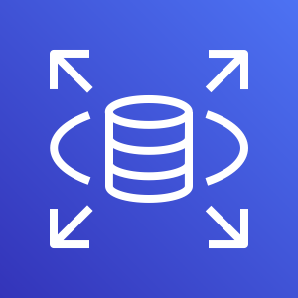

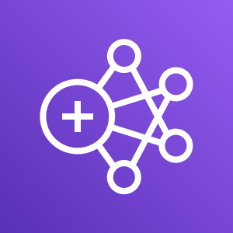
Soda client cloud account
Client data account
Soda user
Soda file
storage on
AWS S3
AWS application
load balancer
AWS Fargate
Soda application docker containers
browser
Soda database
on
AWS RDS MySQL
Soda logs
on
AWS Cloudwatch
& Datadog
Soda Spark
on
AWS EMR
Client data lake on S3
Soda SaaS management platform
Software
updates
Monitoring

